Slide 1


Slide 2
Switch Challenge
Motion Challenge
Deductive Logical Thinking(Geo-Sudo)
Inductive-logical Thinking( find odd man out,whats next)
Grid Challenge (multitasking)
Digit Challenge (numero)
The Same Rule (oddo)
Colour the Grid

Slide 3
Question 1)your challenge is to put the red ball into the hole, but hey, there are obstacles, some are plastic obstacles that you can move, some are hard rocks, you can’t move them. Try to do this in minimum number of steps
Note – You can move plastic blocks, over the black whole
Everytime you solve a maze correctly you level up.

Slide 4
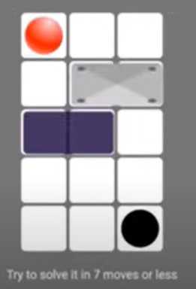
Question 5)

Slide 5
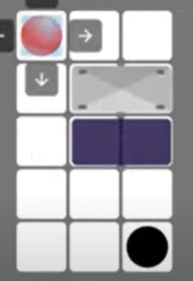
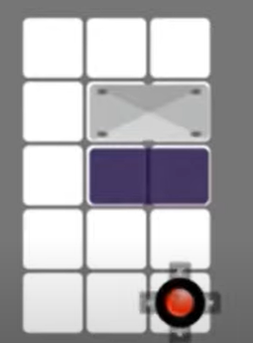
ANSWER:
EXPLAINATION:

Slide 6
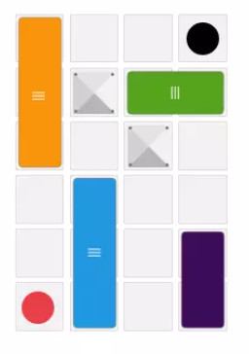
Try to do this in minimum number of steps

Slide 7
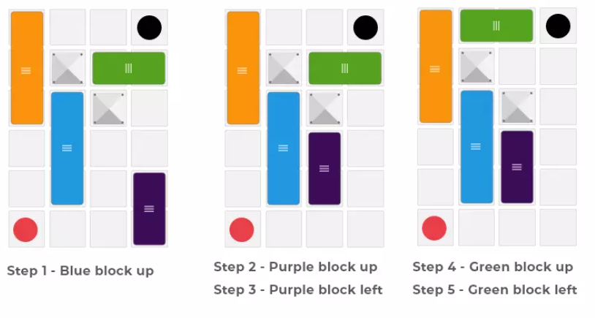
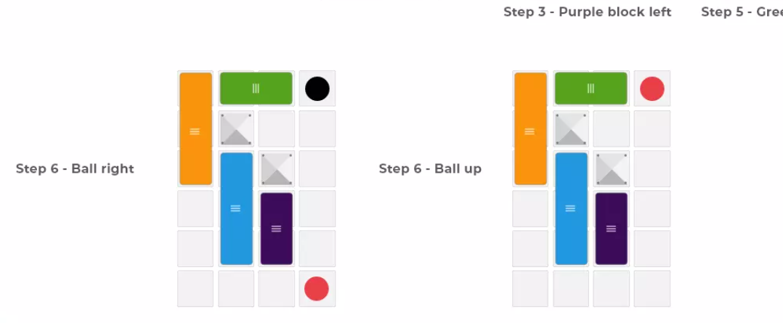

Slide 8
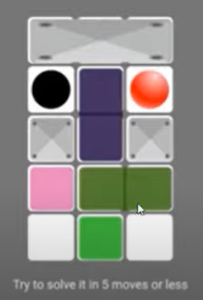
Question ):-

Slide 9
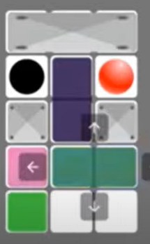
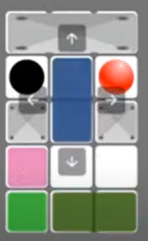
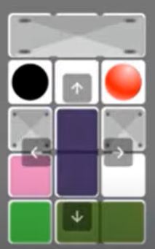
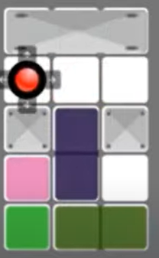
ANSWER:
EXPLAINATION:

Slide 10
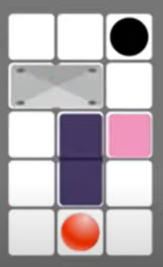
Question

Slide 11
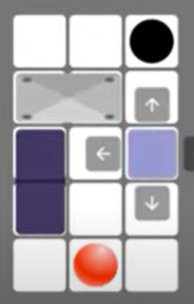
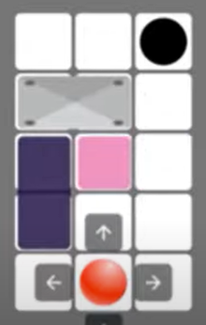
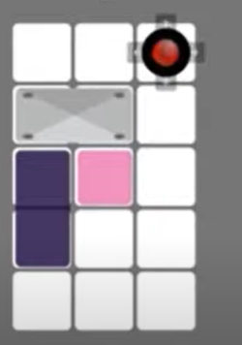
ANSWER:
EXPLAINATION:

Slide 12
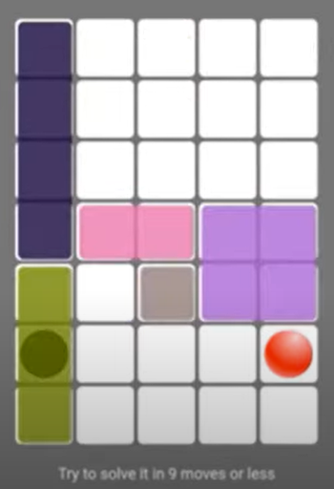
Question )

Slide 13
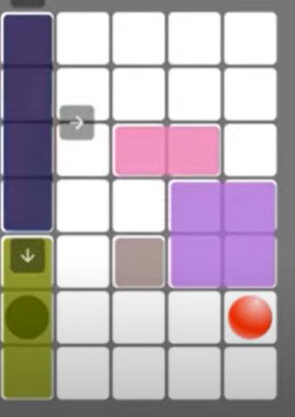
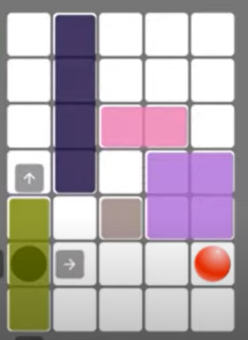
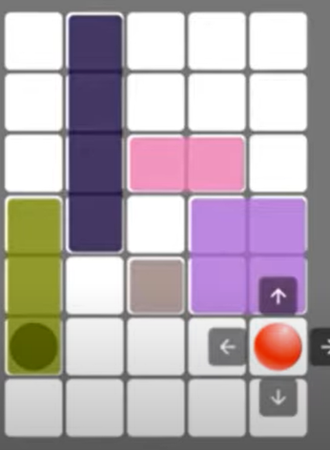
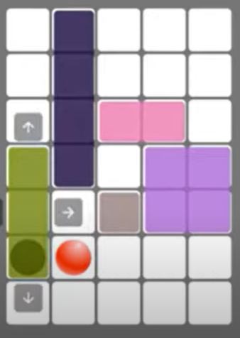
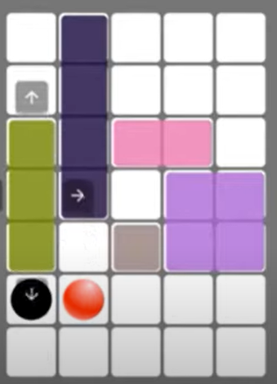
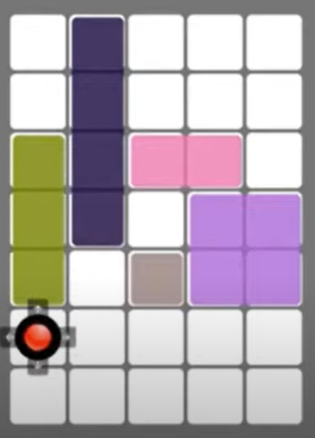
ANSWER:
EXPLAINATION:

Slide 14
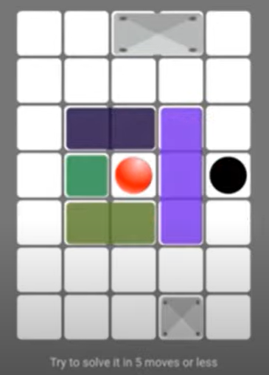
Question )

Slide 15
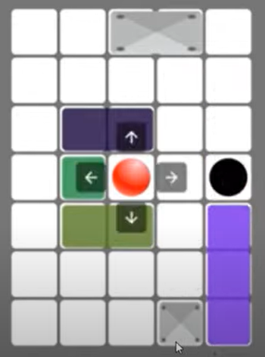
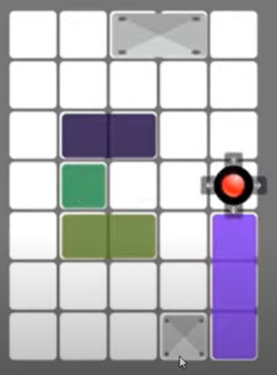
ANSWER:
EXPLAINATION:

Slide 16
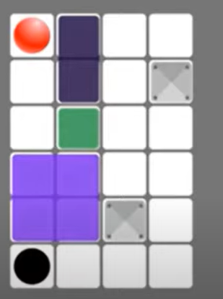
Question 7)

Slide 17
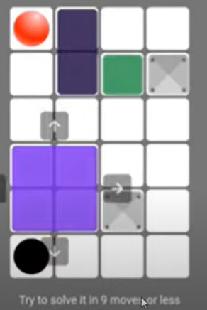
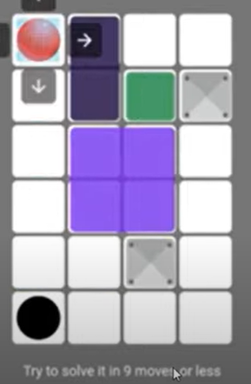
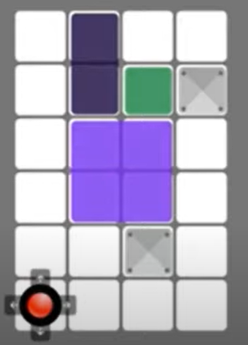
ANSWER:
EXPLAINATION:

Slide 18
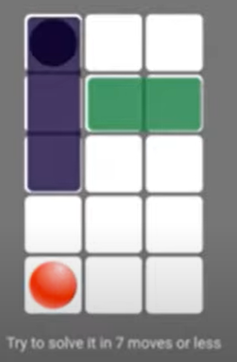
Question 8)

Slide 19
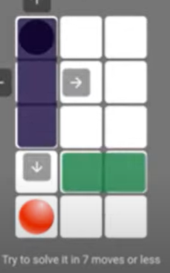
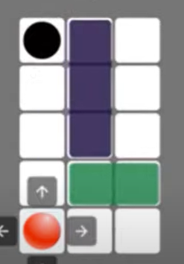
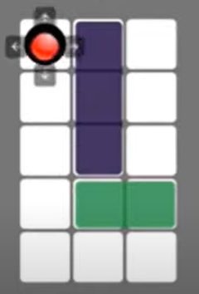
ANSWER:
EXPLAINATION:

Slide 20
Deductive Logical Thinking (Geo-Sudo Challenge)
Rules to Solve
Problem Statement: You’re given a 4×4 or 5×5 or 6×6 grid. You’re supposed to find the missing value based on some rules
Decoding Rules
One geometrical shape can only occur once, in any row or any column

Slide 21
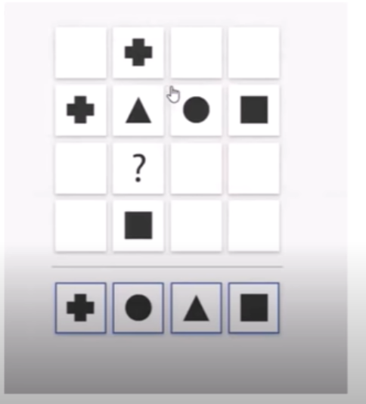
QUESTION 1):

Slide 22
ANSWER: CIRCLE

Slide 23
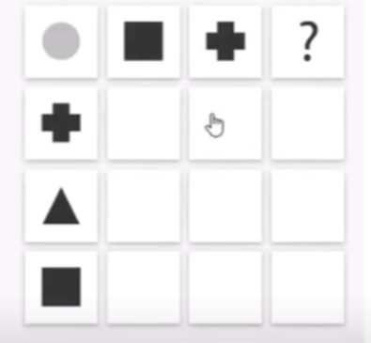
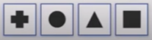
QUESTION 2):

Slide 24
ANSWER: TRIANGLE

Slide 25
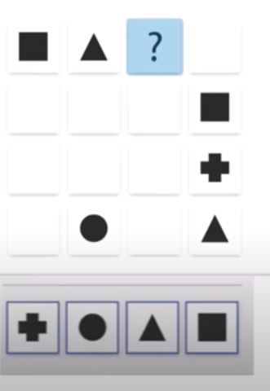
QUESTION 3):

Slide 26
ANSWER: PLUS

Slide 27
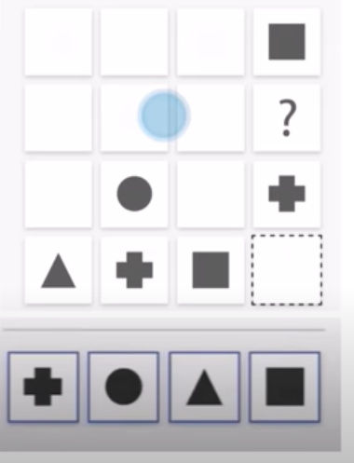
QUESTION 4):

Slide 28
ANSWER: TRIANGLE

Slide 29
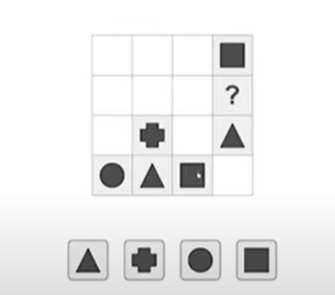
QUESTION 11):

Slide 30
ANSWER: CIRCLE

Slide 31
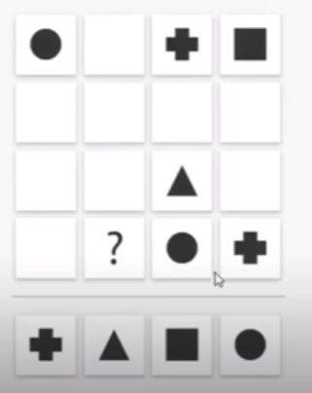
QUESTION 5):

Slide 32
ANSWER: SQUARE

Slide 33
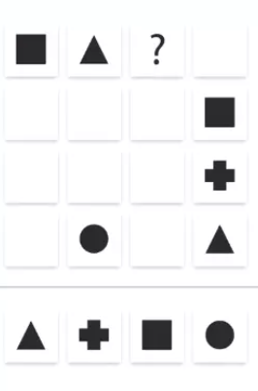
QUESTION 9):

Slide 34
ANSWER: PLUS

Slide 35
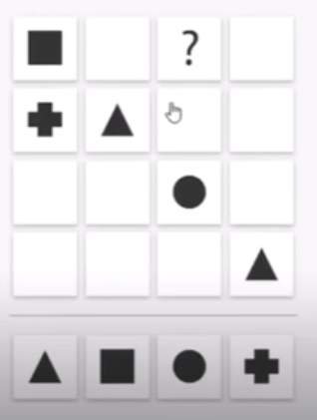
QUESTION 6):

Slide 36
ANSWER: TRIANGLE

Slide 37
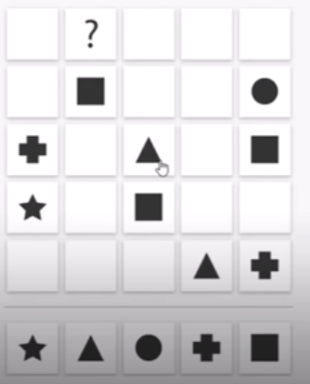
QUESTION 7):

Slide 38
ANSWER: TRIANGLE

Slide 39
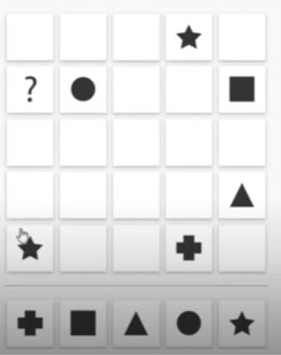
QUESTION 8):

Slide 40
ANSWER: PLUS

Slide 41
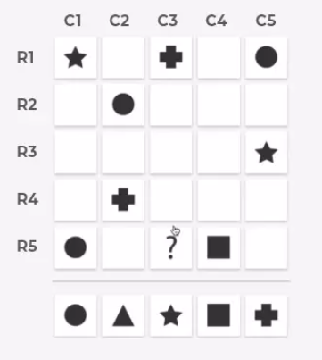
QUESTION 10):

Slide 42
ANSWER: TRIANGLE

Slide 43
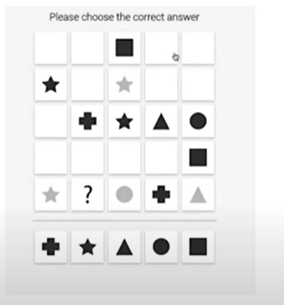
QUESTION 12):

Slide 44
ANSWER: SQUARE

Slide 45
3) Inductive logical thinking:
Object challenge

Slide 46
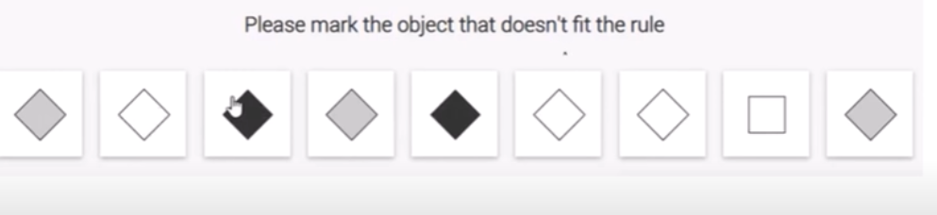
QUESTION 1):

Slide 47
ANSWER:
EXPLAINATION

Slide 48
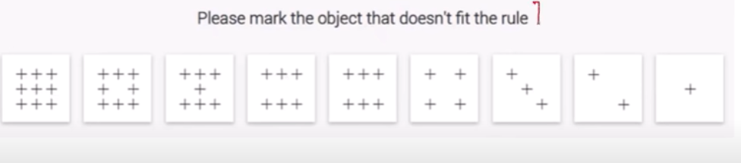
QUESTION 2):

Slide 49
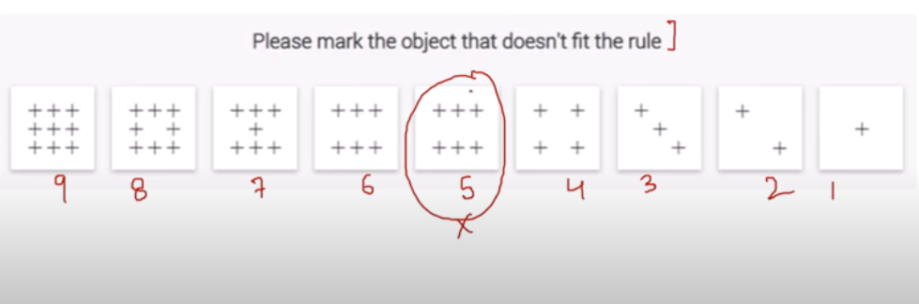
ANSWER:
EXPLAINATION:

Slide 50
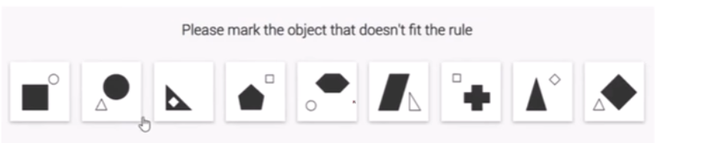
QUESTION 3):

Slide 51

ANSWER:
EXPLAINATION:

Slide 52

QUESTION 4):

Slide 53

ANSWER:
EXPLAINATION:

Slide 54

QUESTION 5):

Slide 55

ANSWER:
EXPLAINATION:

Slide 56

QUESTION 6):

Slide 57

ANSWER:
EXPLAINATION:

Slide 58

QUESTION 7):

Slide 59

ANSWER:
EXPLAINATION:

Slide 60

QUESTION 8):

Slide 61

ANSWER:
EXPLAINATION:

Slide 62

QUESTION 9):

Slide 63

ANSWER:
EXPLAINATION:

Slide 64

QUESTION 10):

Slide 65

ANSWER:
EXPLAINATION:

Slide 66
THANK YOU

